Slide 1

Mini-Project 2
Abel Lagonell
Michael Yong
Jaleel Rogers

Slide 2



Agenda
Objective
Algorithm Design
Experiment Design
Q&A
Works Cited

Slide 3
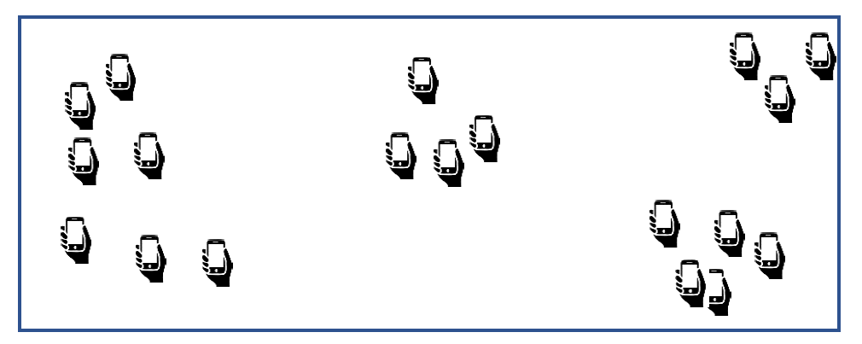
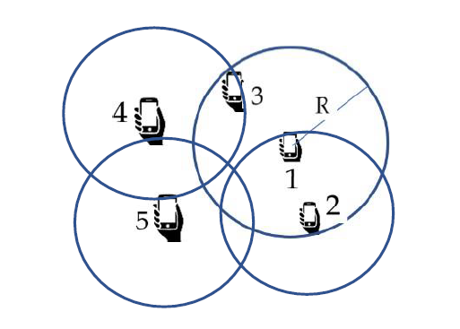
Objective
Sketch and Collect Data to all citizens of Lakeland owning a smartphone in the form of:
  GPS locations (clustered)
  Maximize coverage at minimum cost
  Number of participants: 18
  Grid size 100x100 units
  Budgets: 10,12,20, 25,40
  Radius: 5
Contrast Acquisition Models
  Random, Pure Greedy, Greedy Set Cover, Dynamic

Slide 4

Algorithm Design

Slide 5

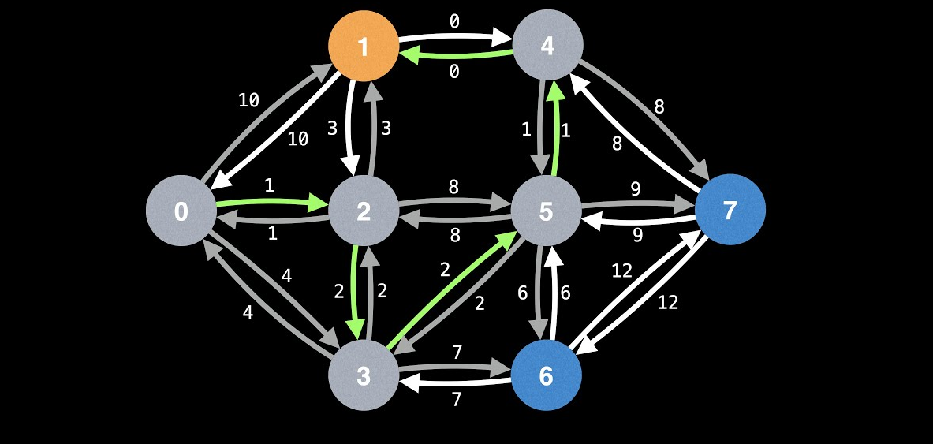
What Makes a Program Dynamic
Dividing a problem into sub-problems
  Solve the larger problem
Looks up instead of re-computing
Tabulation and memorization
Bottom-up & Top-down approaches

Slide 6
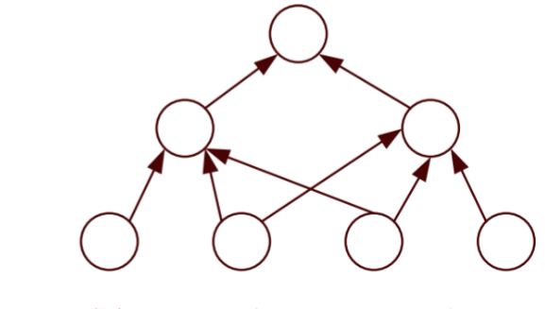
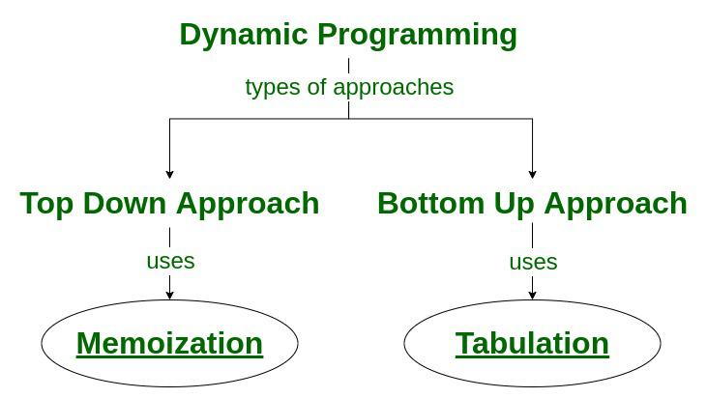
Bottom-up
Problem is divided into a series of sub-problems
  Sub-problems are solved then stored to solve larger instances
  Tabulation rather than memorization
  Efficient runtime, flexible storage compacity, scalable
  More conditions == more complexity
Notes:
Can talk about top-down as a side-note
Iterative

Slide 7
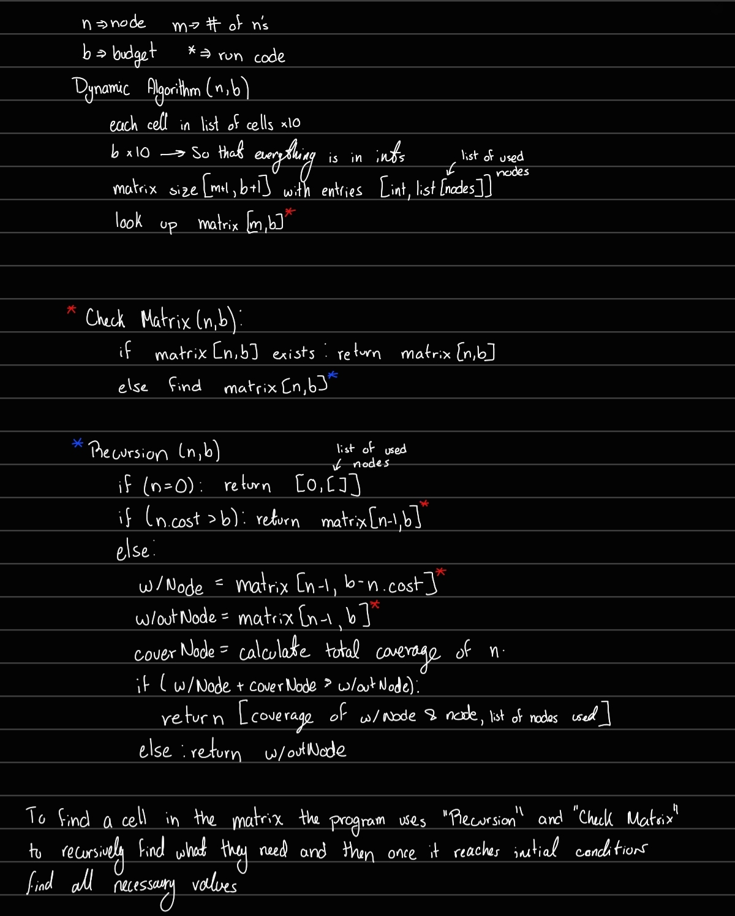
Dynamic Program Algorithm

Slide 8
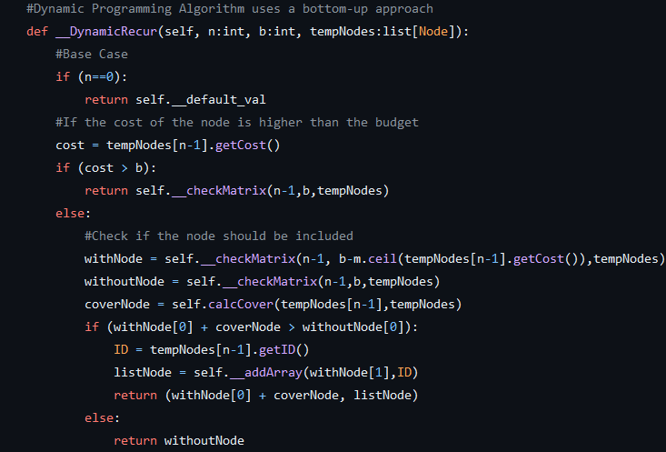
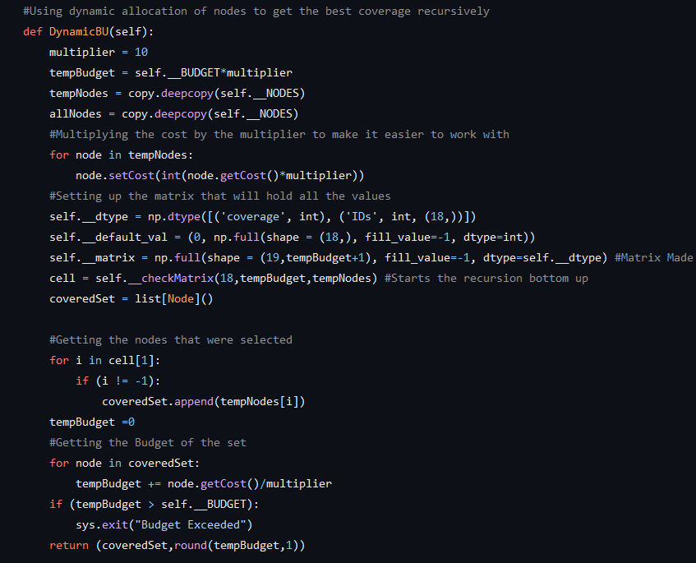
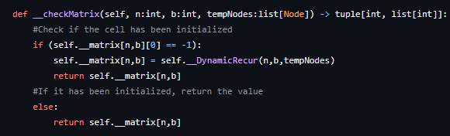

Slide 9

Experiment

Slide 10
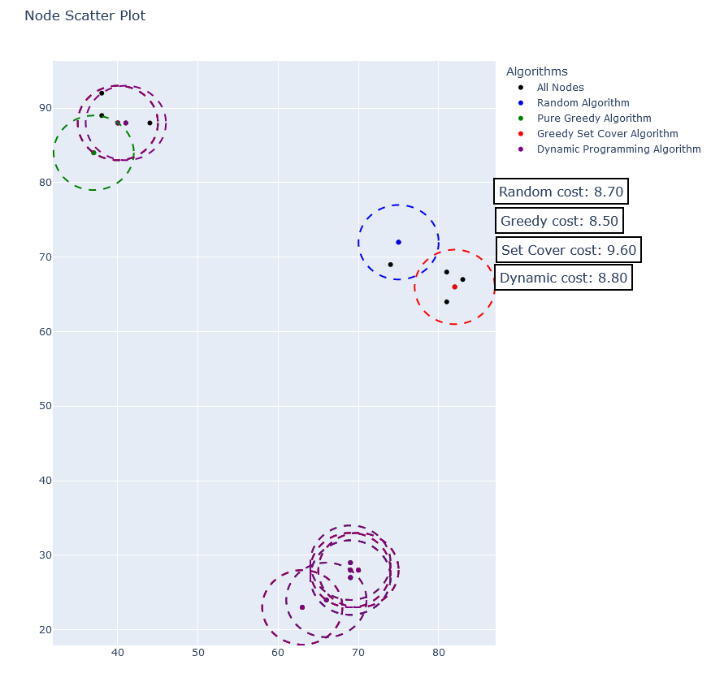
Acquisition Model
Contains all four algorithms on one graph
  With 18 nodes and a budget of 10
Amount of coverage areas vary per algorithm
Algorithms overlap onto each other
Fig.1 Radius Vs. Coverage (Clustered Mode)
Notes:
The Random algorithm selects nodes randomly, while the Pure Greedy algorithm selects the nodes with the lowest cost. The Greedy Set Cover algorithm selects nodes based on their coverage and cost ratio.

Slide 11
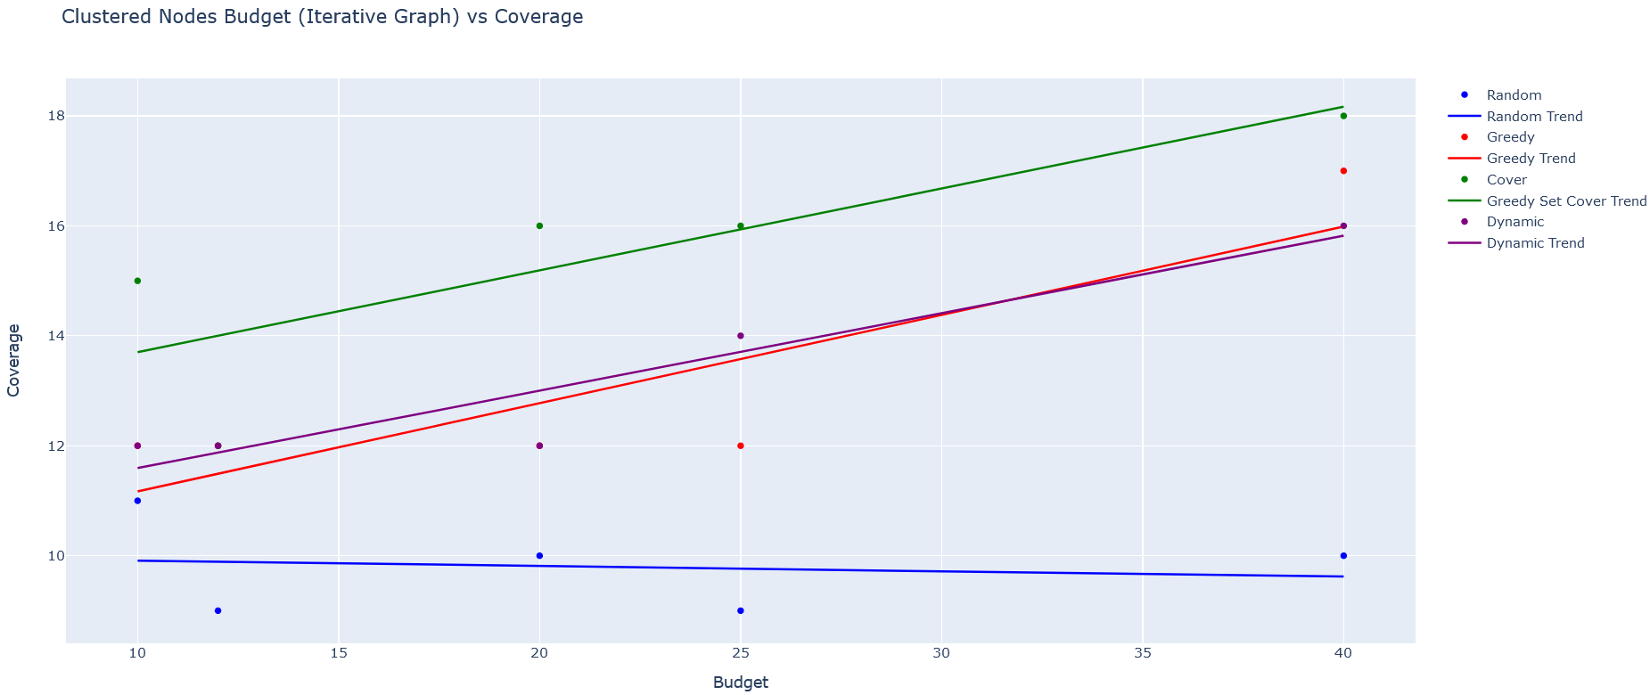
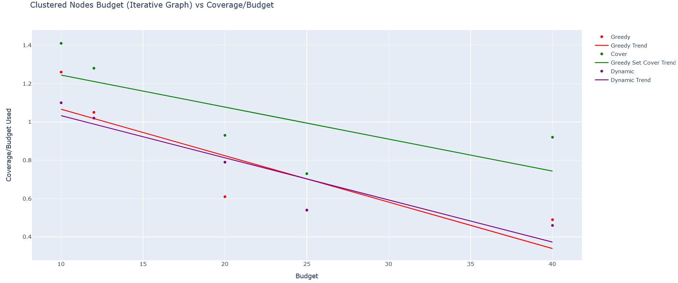
Clustered Budget Vs. Coverage
Greedy & Dynamic perform similar in both multiple tests & single
Random is not as effective as effective
At first positive correlation in first then negative correlation in second

Slide 12
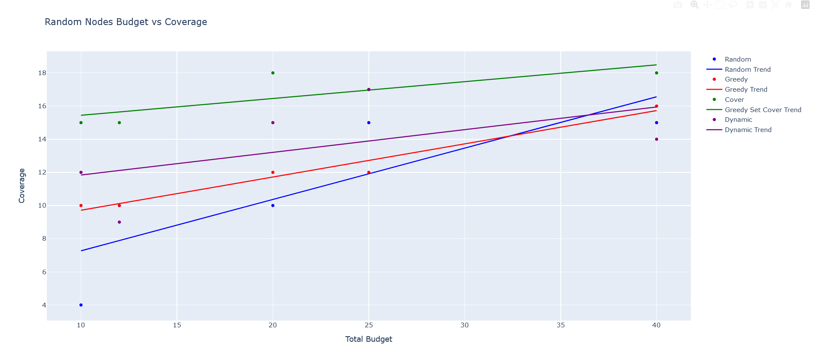
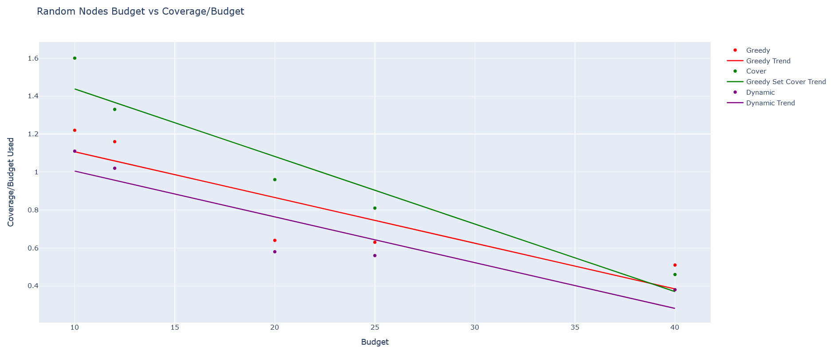
Random Budget Vs. Coverage
In first graph, all algorithms show positive correlation
Random is somewhat effective than compared to other algorithms

Slide 13
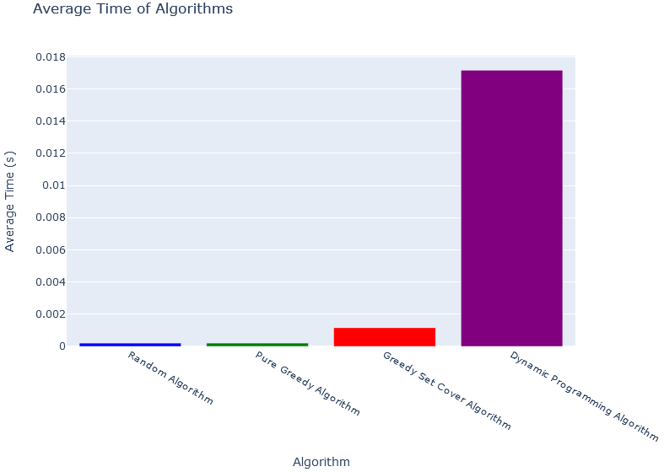
Time Complexity of The Algorithms
Average of algorithms running 10 times with 10 randomized nodes and budget of 50
Processing varies based on computer’s hardware
Consistently Dynamic takes significantly longer
Pure Greedy – O(n)
Random – O(n)
Greedy Set Cover – O(n^2)
Dynamic – O (n^2m)
Notes:
Dynamic may be either O(n^3) or O n log n.

Slide 14


Thank You
Any questions

Slide 15
Works Cited
Plotly (library) - https://plotly.com/python/
Time (library) - https://docs.python.org/3/library/time.html
Numpy (library) - https://numpy.org/

